Slide 1

Proposal
Team7

Slide 2

1.Background
Index
2.Project Overview
3.Development plans
4.Expected Benefits

Slide 3

#01
Background

Slide 4

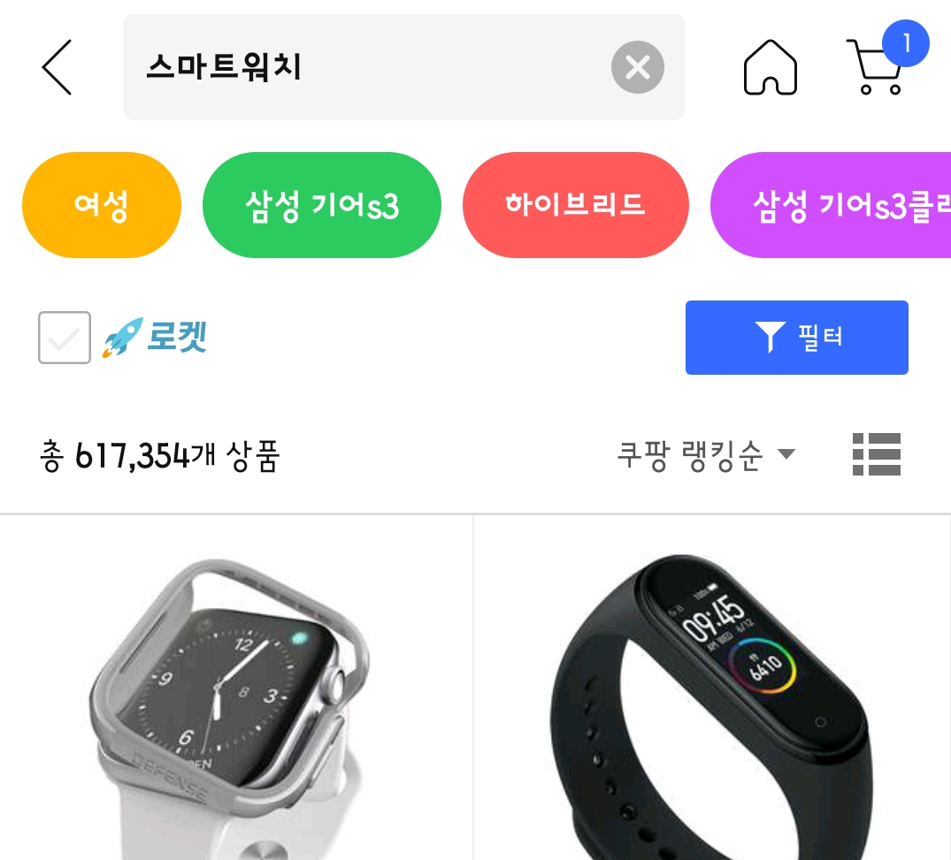
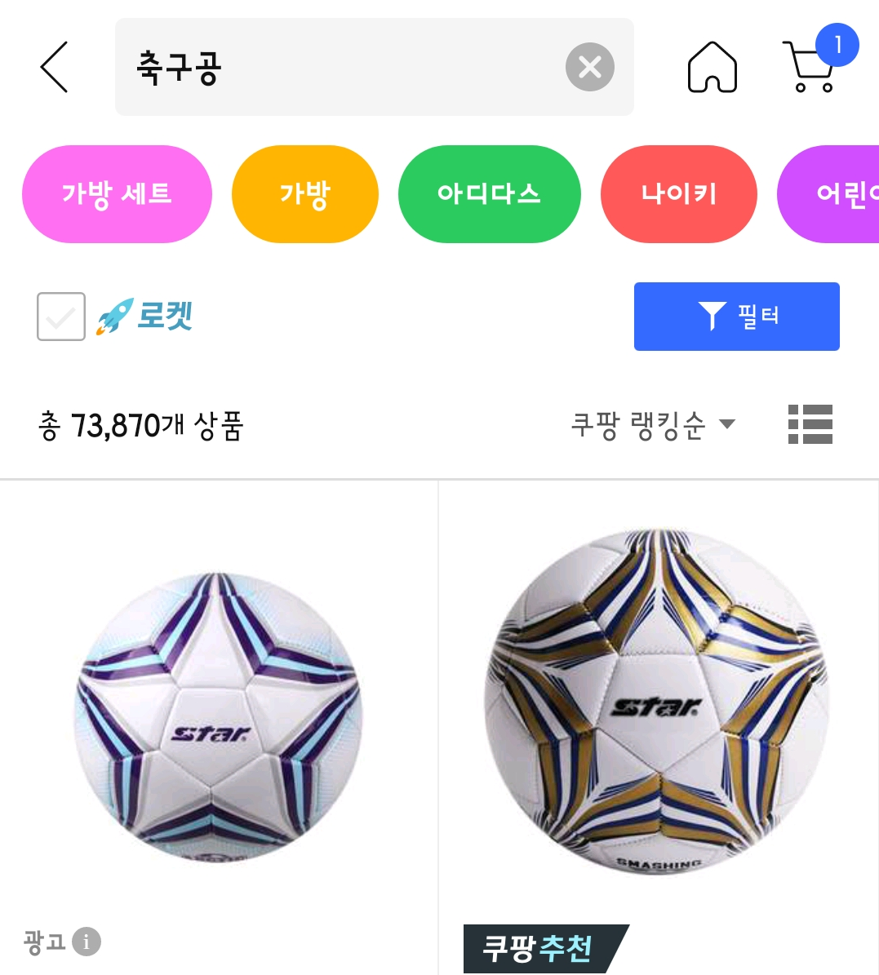
Social Commerce
Hard to decide
Over 600,000 product for keyword “스마트워치”
Too many products
Over 70,000 product for keyword “축구공”

Slide 5



We want
to make it
Providing Various
Category
Easy to Compare
Help you to
Decide

Slide 6
#02
Project
Overview

Slide 7
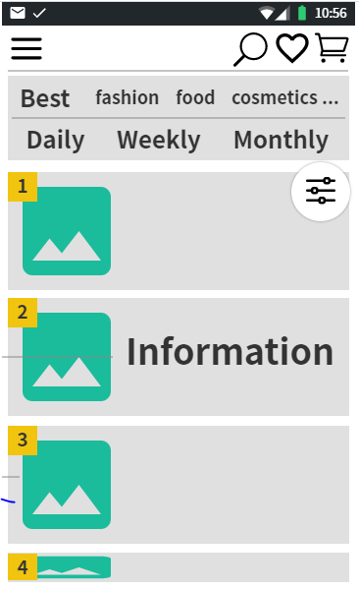
We want to provide various rankings by various options
For example by categories or by period

Slide 8
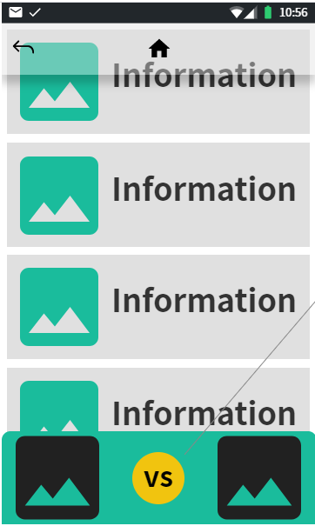
We want to display more comparable data for the products
We want to introduce a special function to help customers to compare various products

Slide 9
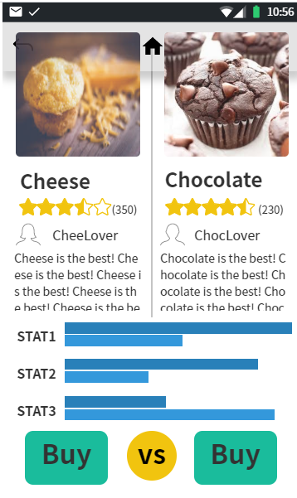
We want to provide a special window for comparing products
We want to provide many comparable data in an easy understandable display to help customers decisions

Slide 10
#03
Development
Plans

Slide 11



Project Plan
Requirement Engineering
~Week 9
Development And Integration
~Week 13
Verification & Validation
~Final Presentation

Slide 12
#04
Expected
Benifits

Slide 13
MODERN
MODERN
본문내용을 넣어주세요

Slide 14
제목
본문내용을 넣어주세요

Slide 15
제목
본문내용을 넣어주세요
MODERN
MODERN
MODERN
본문내용을 넣어주세요
본문내용을 넣어주세요
본문내용을 넣어주세요

Slide 16





f
#1
#2
#3
MODERN
MODERN
MODERN
본문내용을 넣어주세요
본문내용을 넣어주세요
본문내용을 넣어주세요
#4
#5
#6
MODERN
MODERN
MODERN
본문내용을 넣어주세요
본문내용을 넣어주세요
본문내용을 넣어주세요

Slide 18

MODERN
MODERN
본문내용을 넣어주세요
본문내용을 넣어주세요
MODERN
MODERN
본문내용을 넣어주세요
본문내용을 넣어주세요

Slide 19
MODERN
MODERN
본문내용을 넣어주세요
본문내용을 넣어주세요
MODERN
MODERN
본문내용을 넣어주세요
본문내용을 넣어주세요

Slide 20
MODERN
본문내용을 넣어주세요
MODERN
본문내용을 넣어주세요

